Slide 1

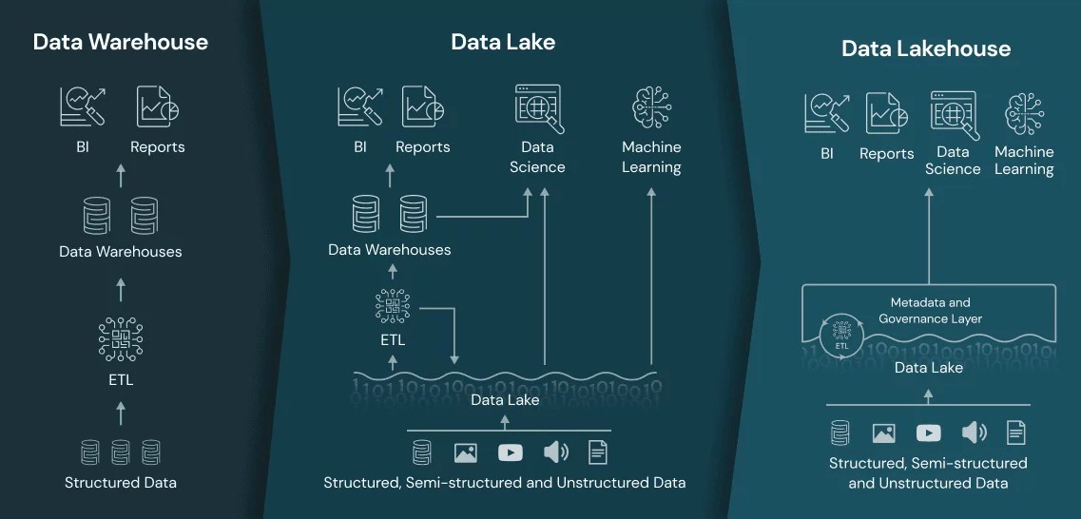

Optimizing Compliance and Efficiency:
Integrating Data Warehouses and Data Lakes under OECD Pillar Two Regulations
Efthymios Galanidis – Ioannis Amourgianos– Dimitrios Xatzis
Derby University
Introduction
Conclusion
With the introduction of Pillar Two regulations by the OECD, organizations face significant challenges in financial data reporting, tax compliance, and regulatory adherence (OECD, 2023). This poster examines the strategic integration of Data Warehouses and Data Lakes within a unified "Lakehouse" architecture to enhance compliance, data governance, financial transparency, and analytical capabilities.
Research Objective
This research aims to evaluate and propose methods enabling businesses to align their data architectures efficiently with Pillar Two regulations, optimizing compliance reporting, risk assessment, and automation through Lakehouse architectures.
Data Warehouses: Remain crucial for precise and rapid structured financial compliance reporting.
Data Lakes: Provide essential scalability and flexibility for managing diverse regulatory and policy-related datasets.
Lakehouses: Offer an efficient, scalable solution integrating structured financial compliance data with varied regulatory information, supporting advanced analytics, audit trails, and real-time reporting (Armbrust et al., 2020).
Strategic Recommendation: Businesses require an explicitly defined strategic roadmap to align Pillar Two requirements with enterprise data frameworks, optimizing regulatory adherence and data efficiency.
Future work
Methodology
Compliance Dimension | Data Warehouse | Data Lake | Lakehouse
Data Structure | Structured, pre-defined schema | Unstructured, raw data | Structured & Unstructured integrated
Processing Speed (Compliance Queries) | High performance | Variable, generally slower | Balanced performance
Storage Cost | Higher (structured storage optimized) | Lower (scalable object storage) | Moderate (balanced approach)
Real-time Compliance Reporting | Limited real-time capabilities | Limited (due to processing complexity) | Strong real-time capabilities (ACID transactions)
Scalability (for future regulations) | Moderate, limited horizontal scalability | High horizontal scalability | High scalability with structured flexibility
Tax Data Accuracy & Auditability | High (schema-on-write accuracy) | Moderate to Low (schema-on-read) | High (hybrid structured/unstructured)
Pilot Studies: Real-world validation across diverse industries to confirm performance and compliance effectiveness.
Advanced Analytics Integration: Exploration of predictive analytics and machine learning for proactive compliance risk management.
Blockchain Application: Evaluating blockchain's potential to enhance data traceability, auditability, and compliance transparency.
Scalability Studies: Detailed assessment of Lakehouse implementations at large-scale enterprises using cloud infrastructure.
Cross-regulatory Comparison: Analysis of Lakehouse adaptability to evolving global regulations beyond Pillar Two.
Qualitative Analysis: Comprehensive review of OECD regulatory frameworks and contemporary enterprise data management literature.
Quantitative Analysis: Benchmarking performance metrics using TPC-DS benchmarks to assess read performance and scalability of Data Warehouses, Data Lakes, and Lakehouses for compliance tasks (Salqvist, 2023).
Mixed Methods: Industry-specific case studies and empirical data evaluation from financial services, multinational enterprises, and regulatory bodies.
Literature Review
References
The analysis emphasizes that while Data Warehouses offer excellent performance and integration for structured tasks, Data Lakes excel in scalability and cost-effectiveness, particularly for unstructured data (Garg, V, 2023). The Lakehouse architecture integrates the structured data management of Data Warehouses with the flexible storage capabilities of Data Lakes, making it optimal for complex compliance tasks under Pillar Two. (Harby & Zulkernine, 2022; Nambiar & Mundra, 2022)
OECD. (2023). "Pillar Two: Global Minimum Tax Framework." OECD Publishing.
Nambiar, A., & Mundra, D. (2022). "An Overview of Data Warehouse and Data Lake in Modern Enterprise Data Management." Big Data and Cognitive Computing, 6(4), 132.
Harby, A. A., & Zulkernine, F. (2022). "From Data Warehouse to Lakehouse: A Comparative Review." IEEE International Conference on Big Data.
Salqvist, P. (2023). "A Comparative Study of the Data Warehouse and Data Lakehouse Architectures." KTH Royal Institute of Technology.
Garg, V. (2023). Evaluating Data Lakes, Data Warehouses, and NoSQL Databases as Foundations for Modern Analytics Platforms. Journal of Mathematical & Computer Applications, 2(4), 1–3.
Armbrust, M., et al. (2020). "Delta Lake: High-Performance ACID Table Storage over Cloud Object Stores." VLDB Endowment.
Top left Picture: https://www.databricks.com/glossary/data-lakehouse#:~:text=A%20data%20lakehouse%20is%20a,(ML)%20on%20all%20data.

